Slide 1
MLOps Why Now and Challenges
Università di Modena e Reggio Emilia
Prof. Nicola Bicocchi (nicola.bicocchi@unimore.it)

Slide 2
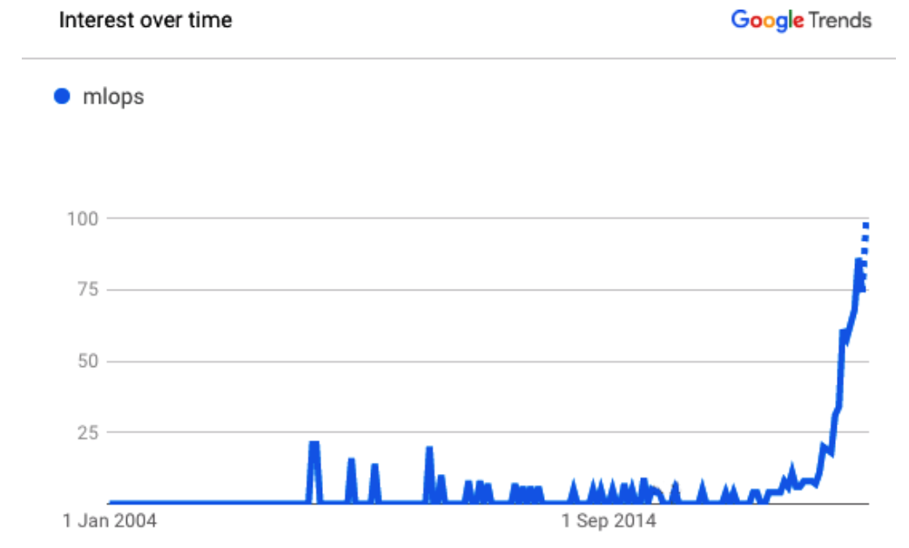
MLOps
Machine learning operations (MLOps) is quickly becoming a critical component of successful data science project deployment in the enterprise.
It’s a process that helps organizations and business leaders generate long-term value and reduce risk associated with data science, machine learning, and AI initiatives.

Slide 3
Terminology
MLOps and ModelOps are largely being used interchangeably. ModelOps is more general than MLOps, as it’s not only about machine learning models but any kind of model (e.g., rule-based models).
AIOps is another topic entirely and refers to the process of solving operational challenges through the use of artificial intelligence (i.e., AI for DevOps). For example, predictive maintenance alerting DevOps teams to possible problems before they arise.
DataOps

Slide 4
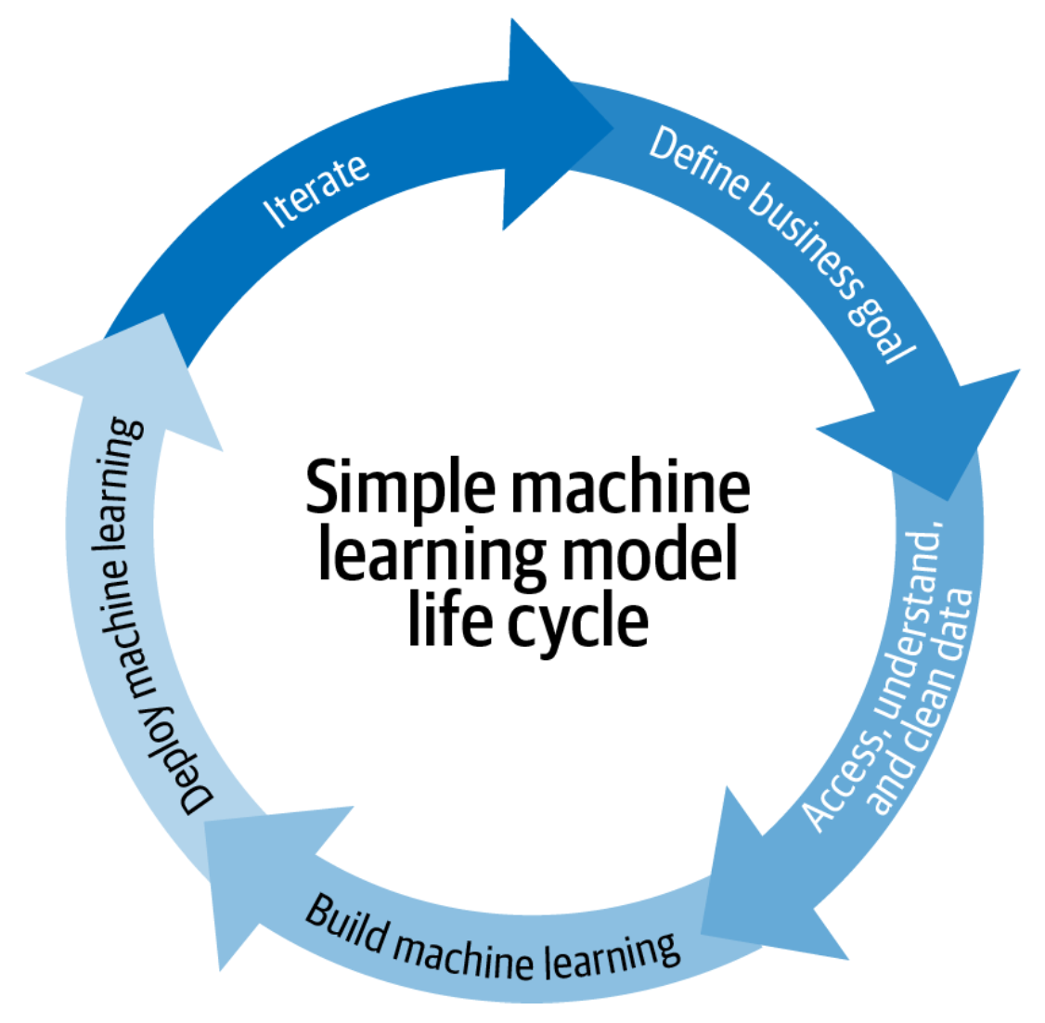
Scale and automation
Until recently, the number of models may have been manageable at a small scale, or there was simply less interest in understanding these models and their dependencies.
With scale and decision automation (an increasing prevalence of decision-making that happens without human intervention), models become more critical, and, in parallel, managing model risks becomes more important at the top level.

Slide 5
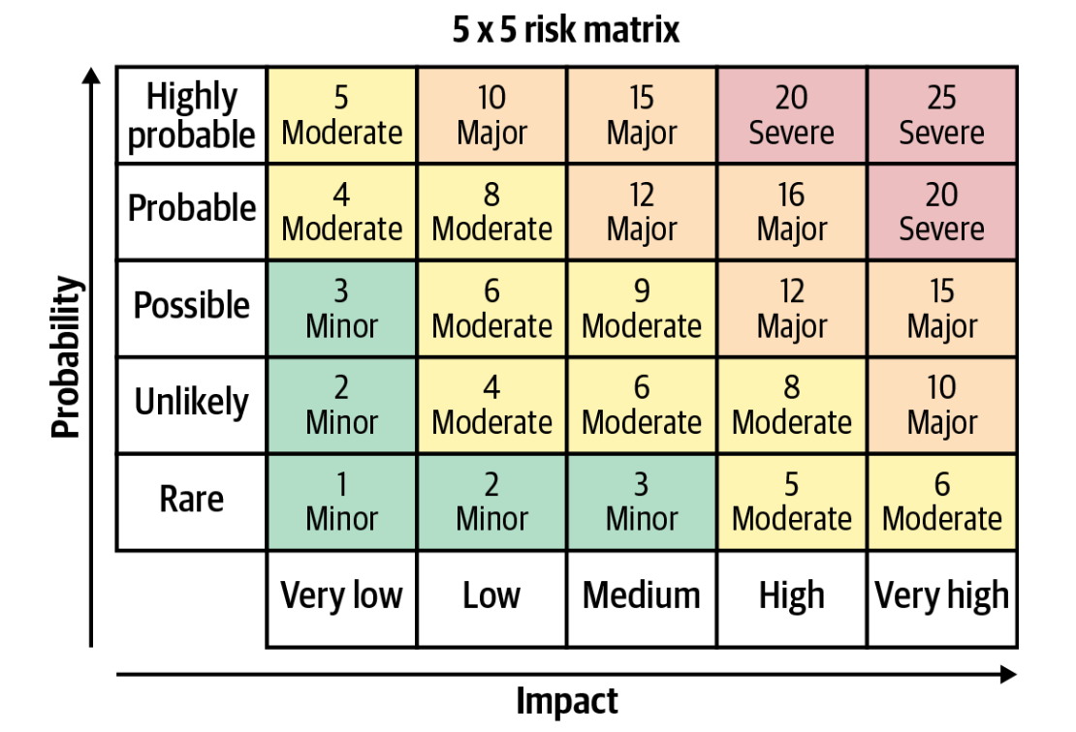
Risk mitigation
When it comes to machine learning models, risks vary widely. For example, the stakes are much lower for a recommendation engine used once a month to decide which marketing offer to send a customer than for a travel site whose pricing and revenue depend on a machine learning model.
The risk that the model is unavailable for a given period of time
The risk that the model returns a bad prediction for a given sample
The risk that the model accuracy or fairness decreases over time
The risk that the skills necessary to maintain the model (i.e., data science talent) are lost

Slide 6
Risk mitigation
Not everyone speaks the same language. The ML life cycle involves people from the business, data science, and IT teams, none of these groups are using the same tools or even, in many cases, share the same fundamental skills to serve as a baseline of communication. Most data scientists are specialized in model building and assessment, and they are not necessarily experts in writing applications.
Learning model performance is often very sensitive to the production environment it is running in, including the versions of software and operating systems in use. They are often built on a pile of open source software (e.g., libraries, like scikit-learn, Python, or Linux), and having versions of this software in production that match those that the model was verified on is critically important.
Data constantly changing, business shifts as well. Results need to be continually relayed back to the business to ensure that the reality of the model in production aligns with expectations and, critically, addresses the original problem or meets the original goal.

Slide 7
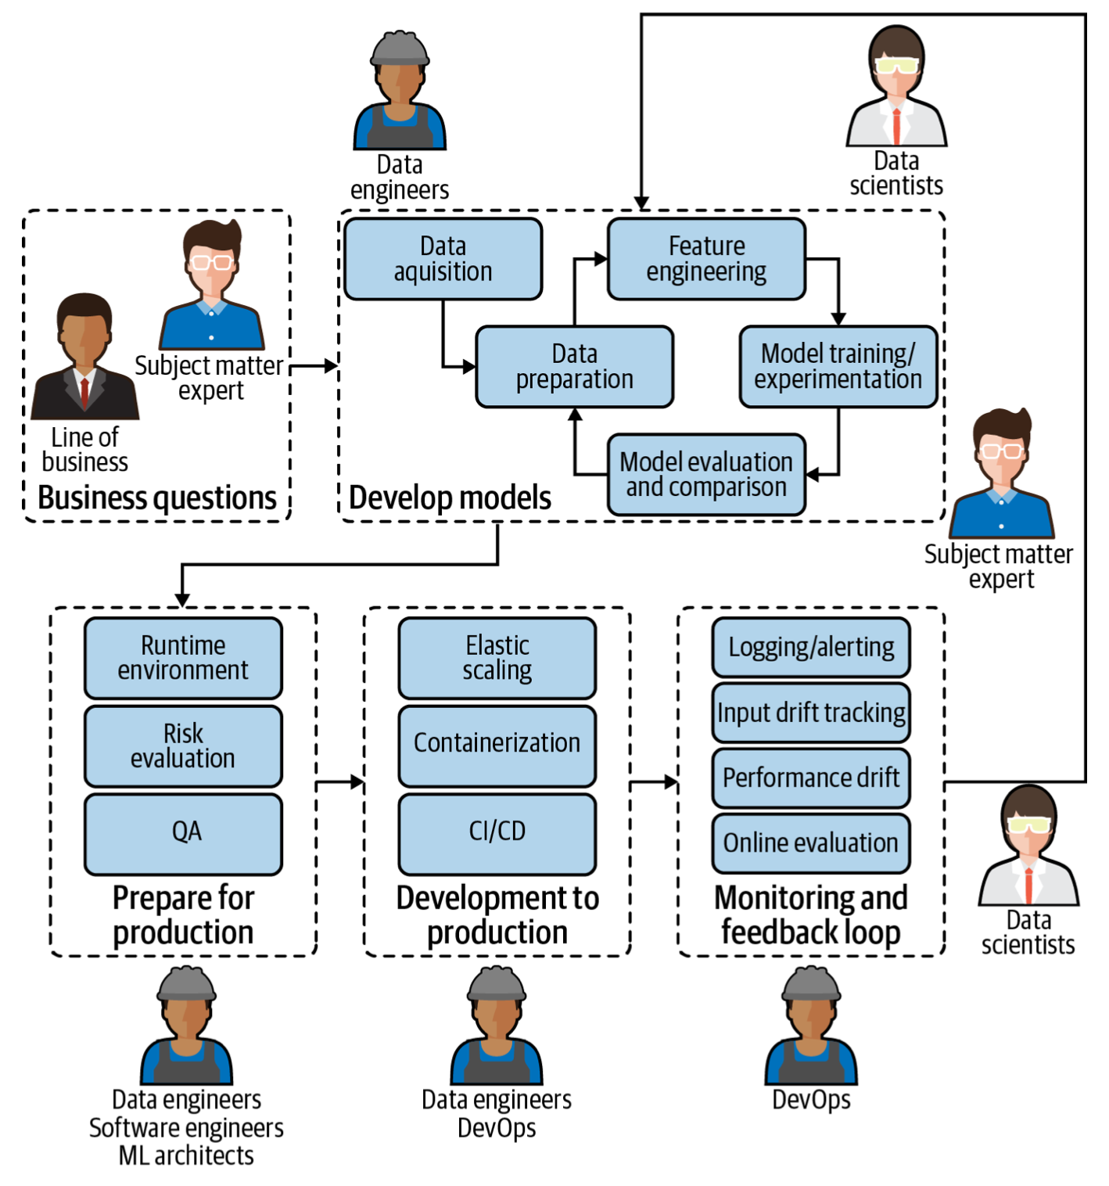
Why Now and Challenges
MLOps and DEVOps share:
Automation and trust between teams
The idea of collaboration and increased communication between teams
The end-to-end service life cycle (build, test, release)
Continuous delivery and high quality
MLOps and DEVOps DO NOT share:
The complexity of the environment, including the fact that machine learning models are made up of both code and data (changing even faster than code)

Slide 8
MLOps for Responsible AI
The reality is that introducing automation vis-à-vis machine learning models shifts the fundamental onus of accountability from the bottom of the hierarchy to the top.
Decisions that were perhaps previously made by individual contributors who operated within a margin of guidelines (for example, what the price of a given product should be or whether or not a person should be accepted for a loan) are now being made by a model. The person responsible for the automated decisions of said model is likely a data team manager or even executive.

Slide 9
MLOps for Responsible AI
Intentionality ensures that models are designed and behave in ways aligned with their purpose. This includes the assurance that data used for AI projects comes from compliant and unbiased sources plus a collaborative approach to AI projects that ensures multiple checks and balances on potential model bias.
Intentionality also includes explainability, meaning the results of AI systems should be explainable by humans (ideally, not just the humans who created the system).
Accountability is about having an overall view of which teams are using what data, how, and in which models. It also includes the need for trust that data is reliable and being collected in accordance with regulations as well as a centralized understanding of which models are used for what business processes.
Closely tied to traceability: if something goes wrong, is it easy to find where in the pipeline it happened?

Slide 10
MLOps for Scale
Going from one or a handful of models in production to tens, hundreds, or thousands that have a positive business impact requires MLOps discipline. Good MLOps practices will help teams at a minimum:
Keep track of versioning, especially with experiments in the design phase
Understand whether retrained models are better than the previous versions (and promoting models to production that are performing better)
Ensure (at defined periods—daily, monthly, etc.) that model performance is not degrading in production

